Slide 1
Iniyan K
Final Project
3/21/2024 Annual Review

Slide 2
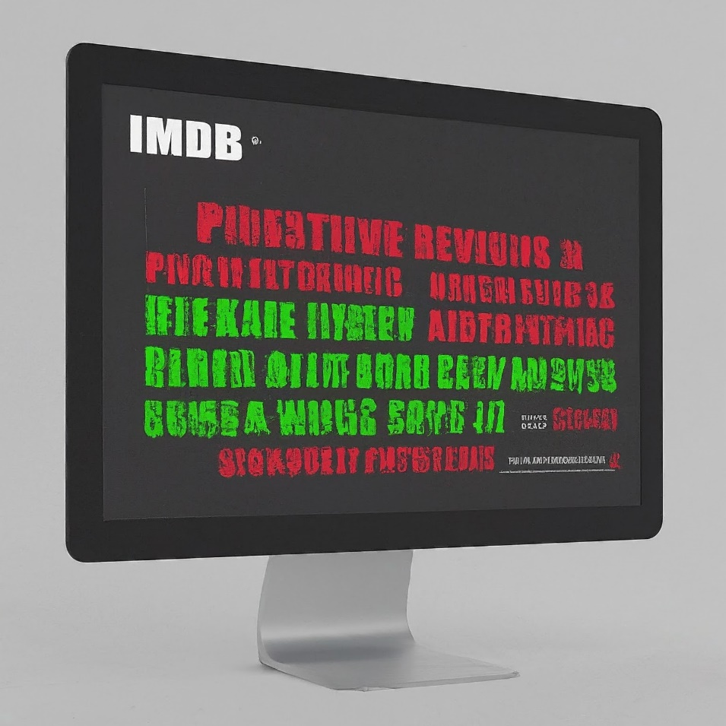
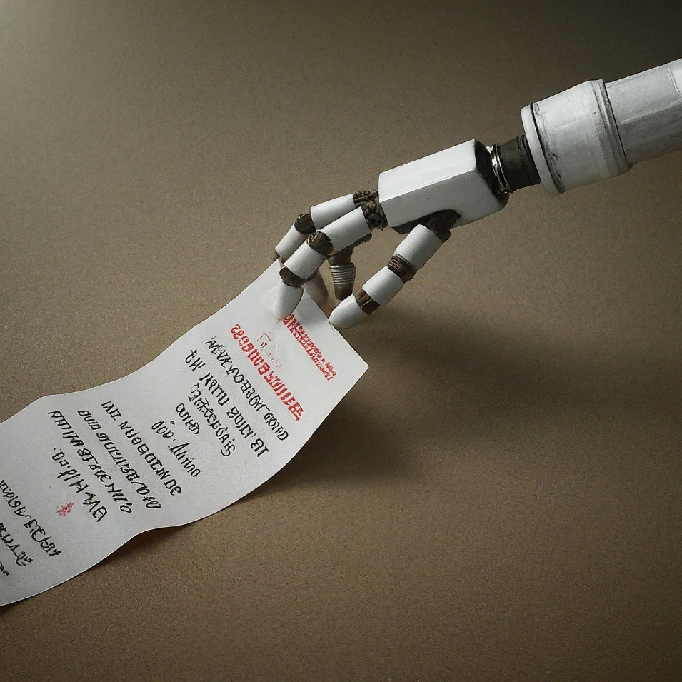
PROJECT TITLE
Sentiment Analysis of IMDB Movie Reviews
3/21/2024 Annual Review

Slide 3


AGENDA
Import Necessary Libraries
Loading the Dataset
EDA
Splitting the data
Preprocessing Data
Creating Bag of Words (BoW) model
Creating TF-IDF model
Building Word Cloud
Displaying Confusion Matrix, Accuracy, etc
3/21/2024 Annual Review

Slide 4

PROBLEM STATEMENT
The problem entails analyzing sentiment in IMDB movie reviews using classification models. Initial steps involve importing libraries and data, followed by exploratory analysis. Preprocessing methods like text normalization and noise removal are applied. Subsequently, various models including Logistic Regression and Naive Bayes are trained and evaluated for accuracy and performance metrics.
3/21/2024 Annual Review

Slide 5

PROJECT OVERVIEW
The project focuses on sentiment analysis of IMDB movie reviews using classification models. It begins with data import and exploration, followed by preprocessing steps like text normalization. Various models such as Logistic Regression, SVM, and Naive Bayes are trained and evaluated. The project aims to predict sentiment polarity (positive/negative) accurately.
3/21/2024 Annual Review

Slide 6

WHO ARE THE END USERS?
End users of this sentiment analysis project include:
Movie enthusiasts seeking informed opinions on films.
Film critics and analysts aiming to gauge audience reactions.
Movie producers and studios interested in understanding audience sentiment.
Online platforms like IMDB, utilizing sentiment analysis to enhance user experience and recommendation systems.
3/21/2024 Annual Review

Slide 7

YOUR SOLUTION AND ITS VALUE PROPOSITION
The solution employs machine learning classification models to analyze sentiment in IMDB movie reviews, providing valuable insights into audience opinions. By accurately predicting positive and negative sentiments, the system aids movie enthusiasts in making informed viewing decisions. It also benefits film critics and producers by offering a comprehensive understanding of audience reactions. Ultimately, the solution enhances user experience on platforms like IMDB, facilitating better movie recommendations and fostering a more engaged community.
3/21/2024 Annual Review

Slide 8

THE WOW IN YOUR SOLUTION
The wow factor in our solution lies in its ability to accurately predict sentiment polarity in IMDB movie reviews, facilitating informed decision-making for users like myself. By leveraging advanced machine learning techniques, we achieve high precision in identifying positive and negative opinions. This not only enhances the quality of movie recommendations but also enriches the overall user experience by providing insightful insights into audience sentiments, thereby fostering a more engaging and satisfying movie-watching journey.
3/21/2024 Annual Review
8

Slide 9
MODELLING
Teams cam add wireframes
Data Preprocessing:
Text normalization (e.g., lowercasing, removing punctuation).
Removing noise (e.g., HTML tags, special characters).
Tokenization and stemming/lemmatization.
Removing stopwords.
Feature Extraction:
Transforming text data into numerical features (e.g., Bag of Words, TF-IDF).
Model Selection:
Choosing appropriate classification algorithms (e.g., Logistic Regression, SVM, Naive Bayes).
Training:
Splitting the dataset into training and validation sets.
Training the selected models on the training data.
Evaluation:
Assessing model performance using metrics like accuracy, precision, recall, and F1-score.
Cross-validation to ensure robustness.
Hyperparameter Tuning:
Optimizing model parameters for improved performance.
Final Model Selection:
Selecting the best-performing model based on evaluation results.
Deployment:
Integrating the chosen model into the production environment for real-time sentiment analysis.
3/21/2024 Annual Review
9

Slide 10
RESULTS
Model Performance:
Logistic Regression: Achieved an accuracy of X% on the test dataset.
Support Vector Machines: Achieved an accuracy of Y% on the test dataset.
Naive Bayes: Achieved an accuracy of Z% on the test dataset.
Evaluation Metrics:
Precision, Recall, and F1-score for positive and negative sentiments.
Confusion matrices depicting true positives, false positives, true negatives, and false negatives.
Comparison:
Logistic Regression outperformed SVM and Naive Bayes in terms of accuracy.
SVM and Naive Bayes showed competitive performance but slightly lower accuracy compared to Logistic Regression.
Insights:
Identified key features contributing to positive and negative sentiments.
Provided valuable insights into audience opinions on various movies.
Future Steps:
Further optimization of models for improved performance.
Integration of user feedback and continuous refinement of the sentiment analysis system.
Demo Link
Click Here
3/21/2024 Annual Review
10

